Slide 1
Phonics Screening Check

Slide 2

What is phonics?
Children begin to learn phonics in the Early Years, both Nursery and Reception.
Once children begin learning sounds they use this knowledge to read and spell words. Children can then see the purpose of learning sounds. For this reason, the initial sounds that are taught are ‘s’, ‘a’, ‘t’, ‘p’, ‘i’, ‘n’.
These can immediately be blended for reading to make simple CVC (consonant, vowel, consonant) e.g. sat, pin, tap. Children then develop segmenting for writing skills; breaking the word into sounds to spell it out.

Slide 3















Initial Code
Extended Code

Slide 4



Statutory Phonics Screening Check
Throughout the country, children in Year 1 will be taking part in a phonics screening check during the same week in June. Children in Year 2 will also take the check if they did not achieve the required result when in Year 1.
The purpose of the check is to confirm that children have learned phonic decoding to an age-expected standard.
Age related expectation for the end of Year 1 is all of the units we teach in the Initial Code and the Extended Code for Year 1

Slide 5
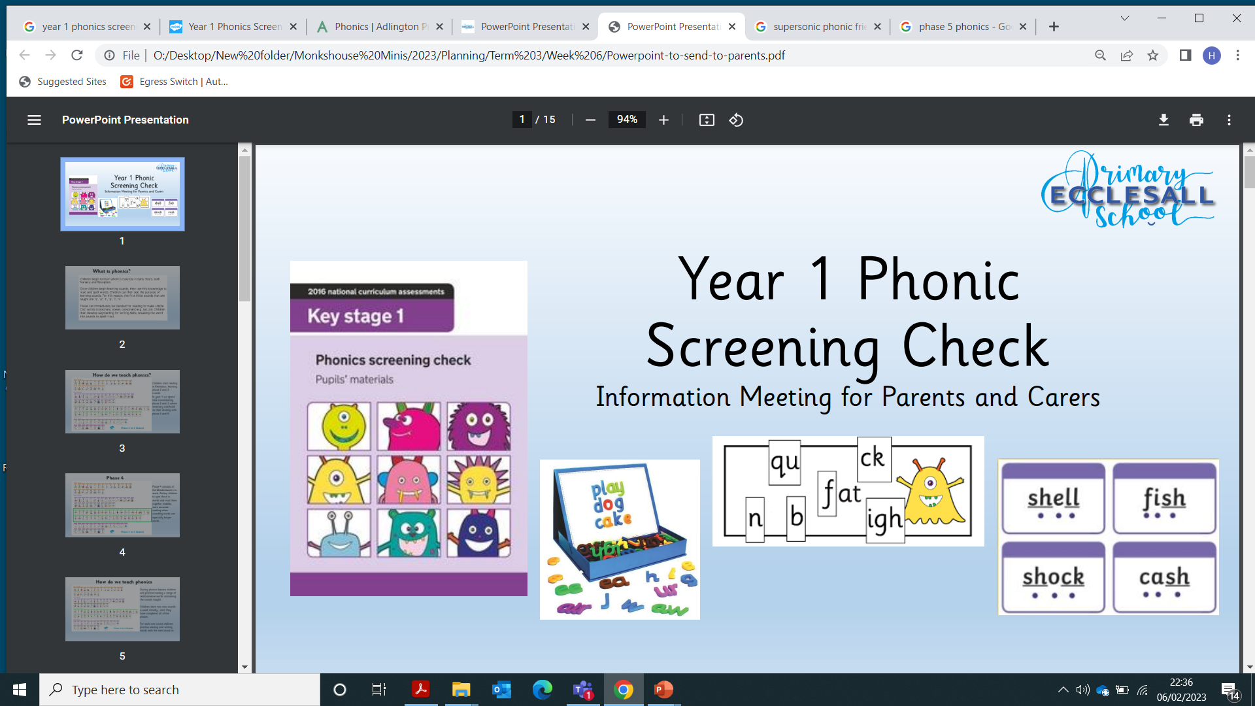
What happens during the check?
Children will work 1:1 with a member of staff familiar to them.
They are asked to read 40 words.
The check takes approximately 10 minutes per child although this can vary depending on each child’s needs.

Slide 6
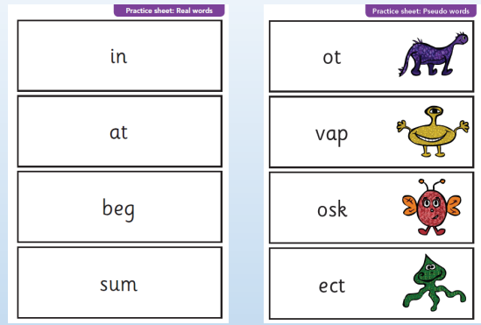
The Screening Check
The children are asked to read 40 words; 20 real words and 20 nonsense words. The idea behind this is to assess whether children know their phonics and can decode words. Nonsense words are included because they assess actual phonic knowledge and do not favour any child who may be particularly good at remembering words by sight.

Slide 7
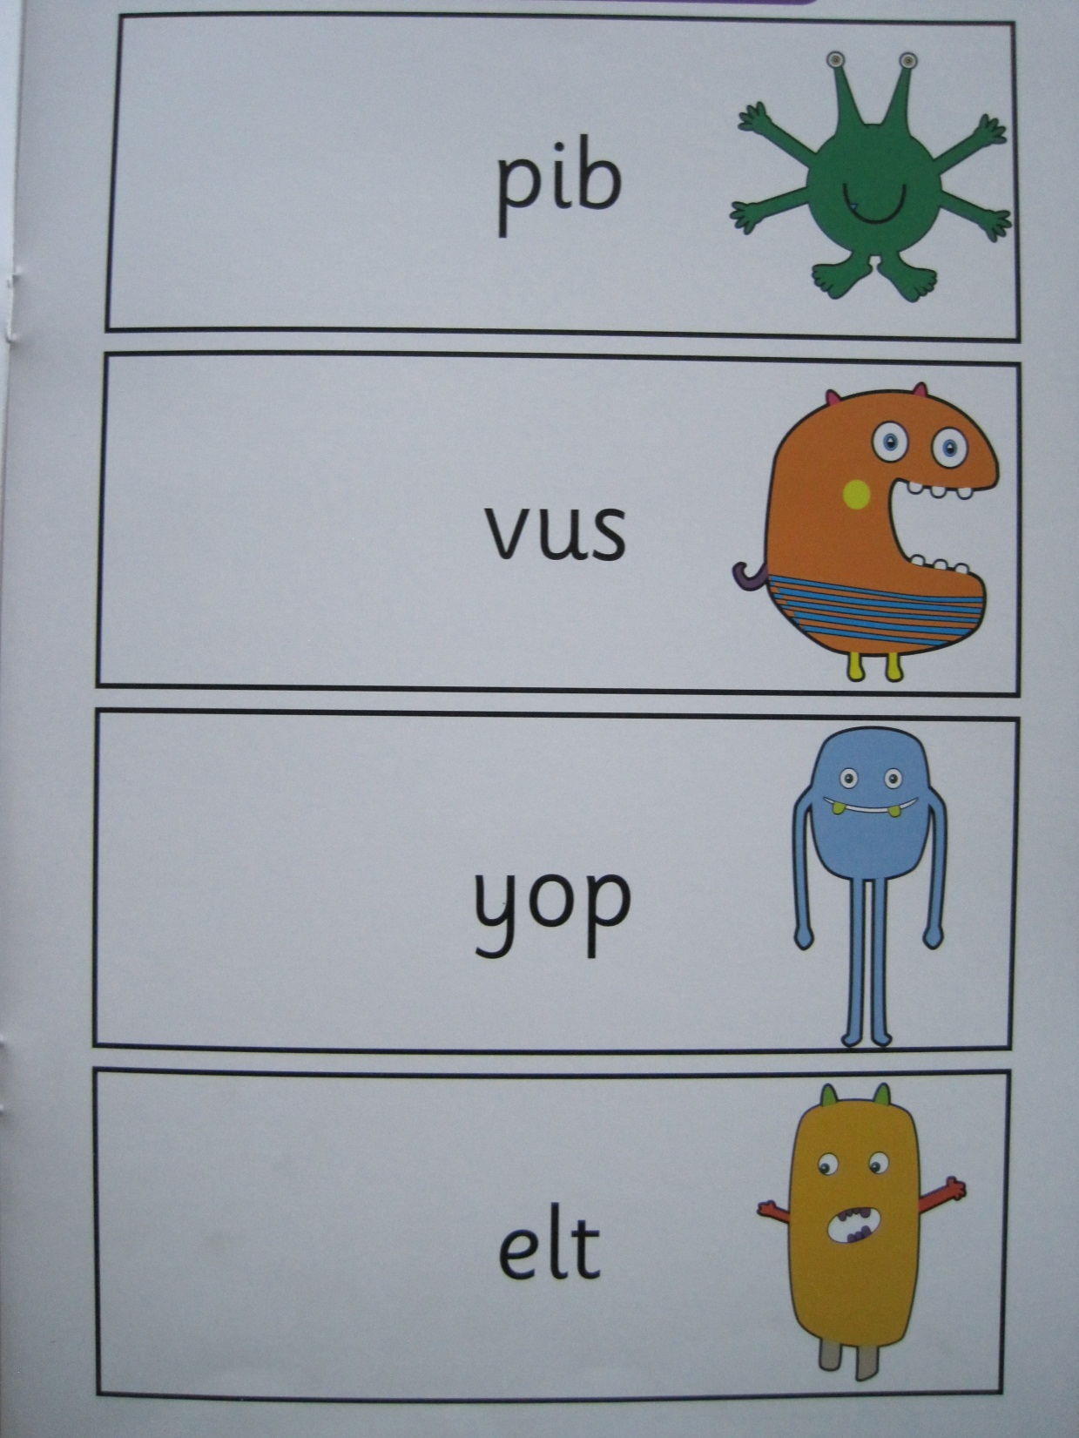
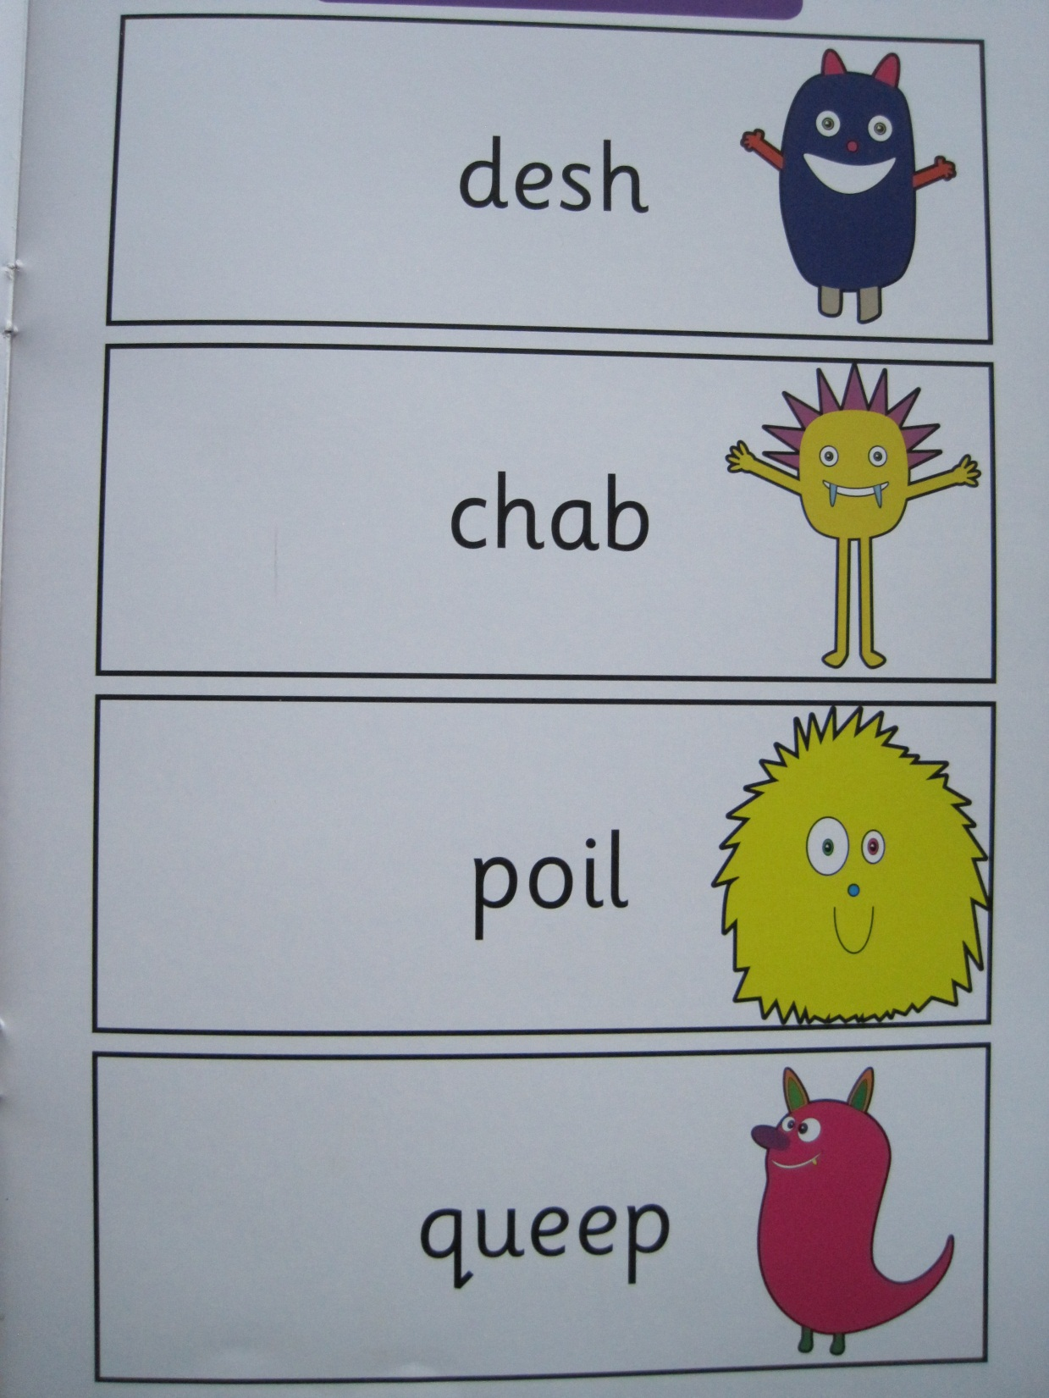

Slide 8
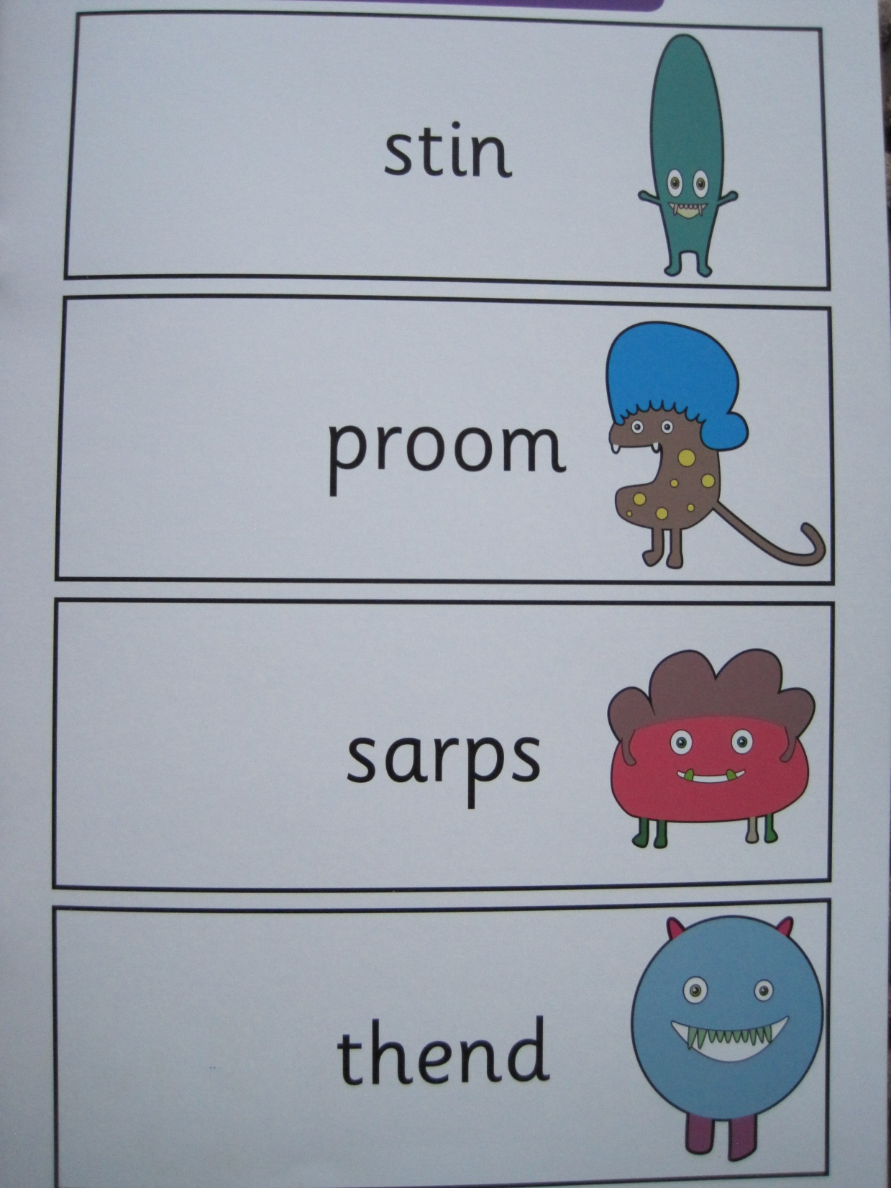
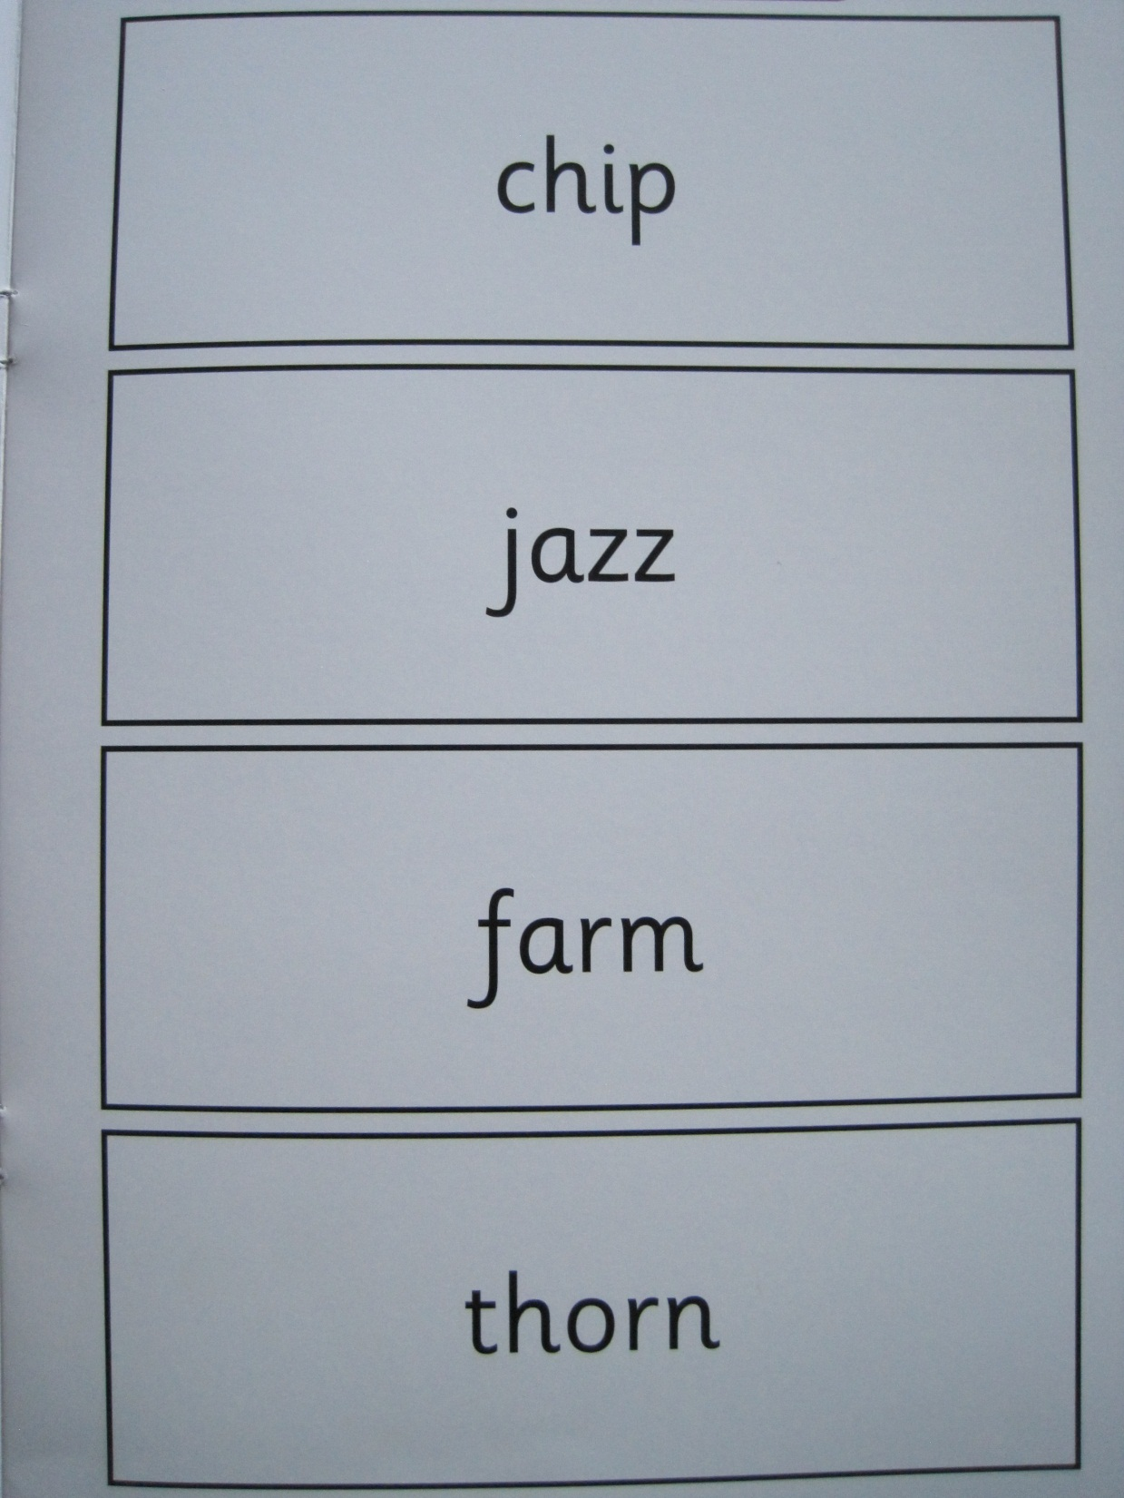

Slide 9
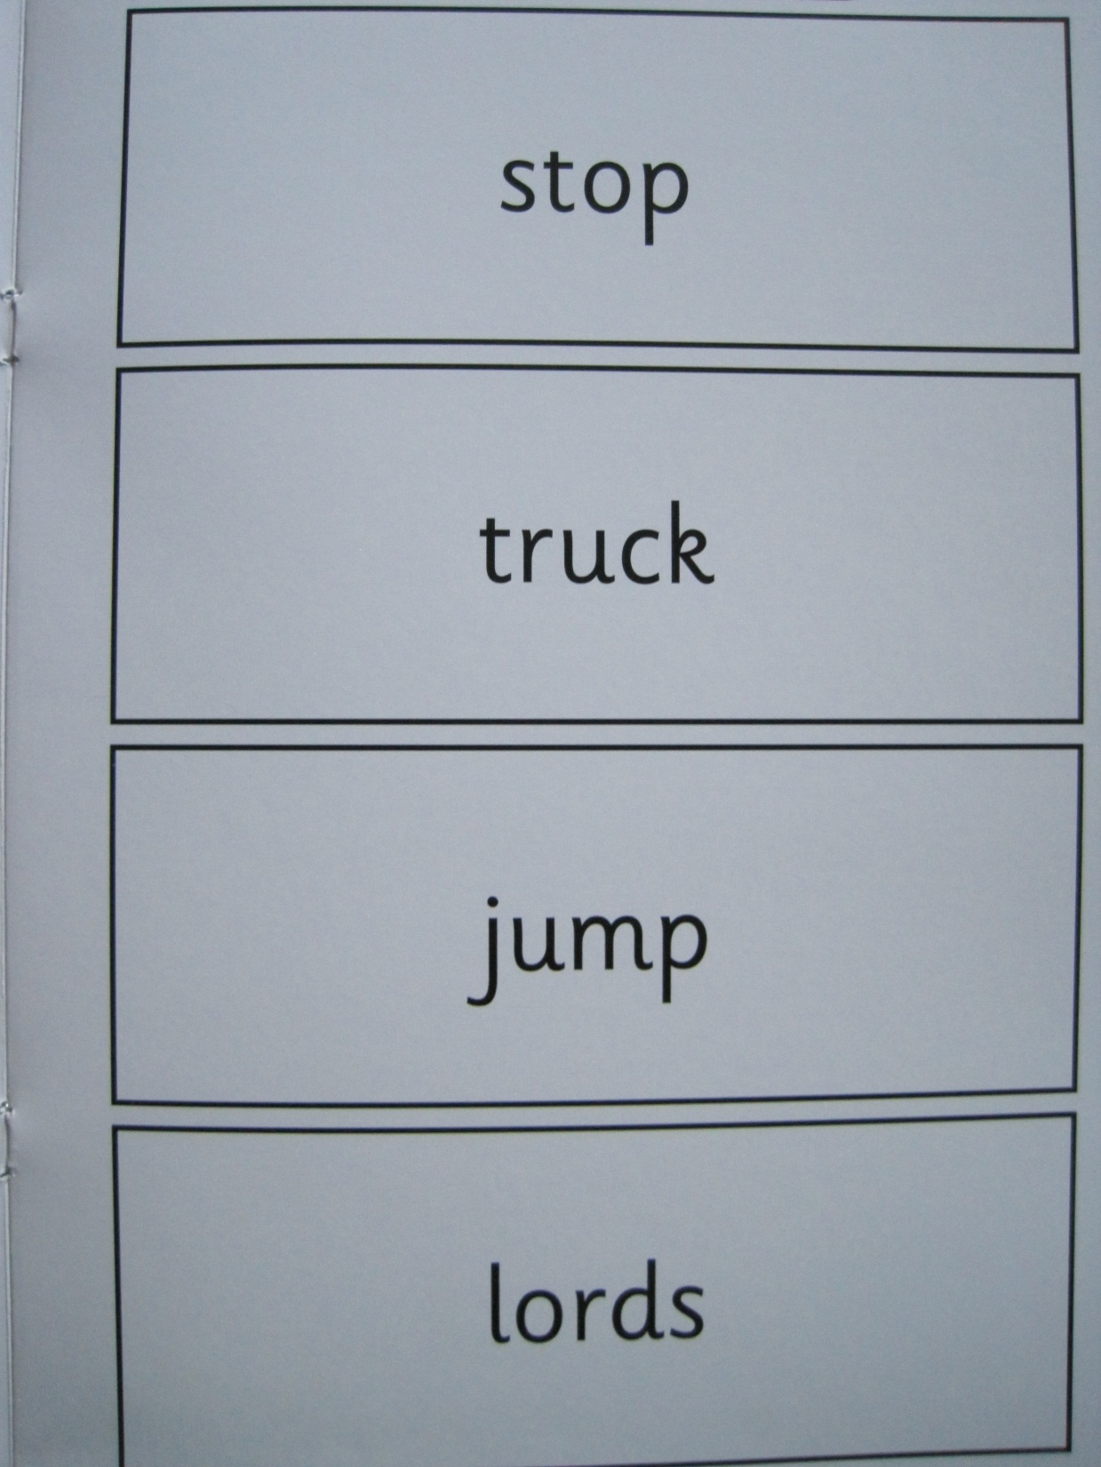
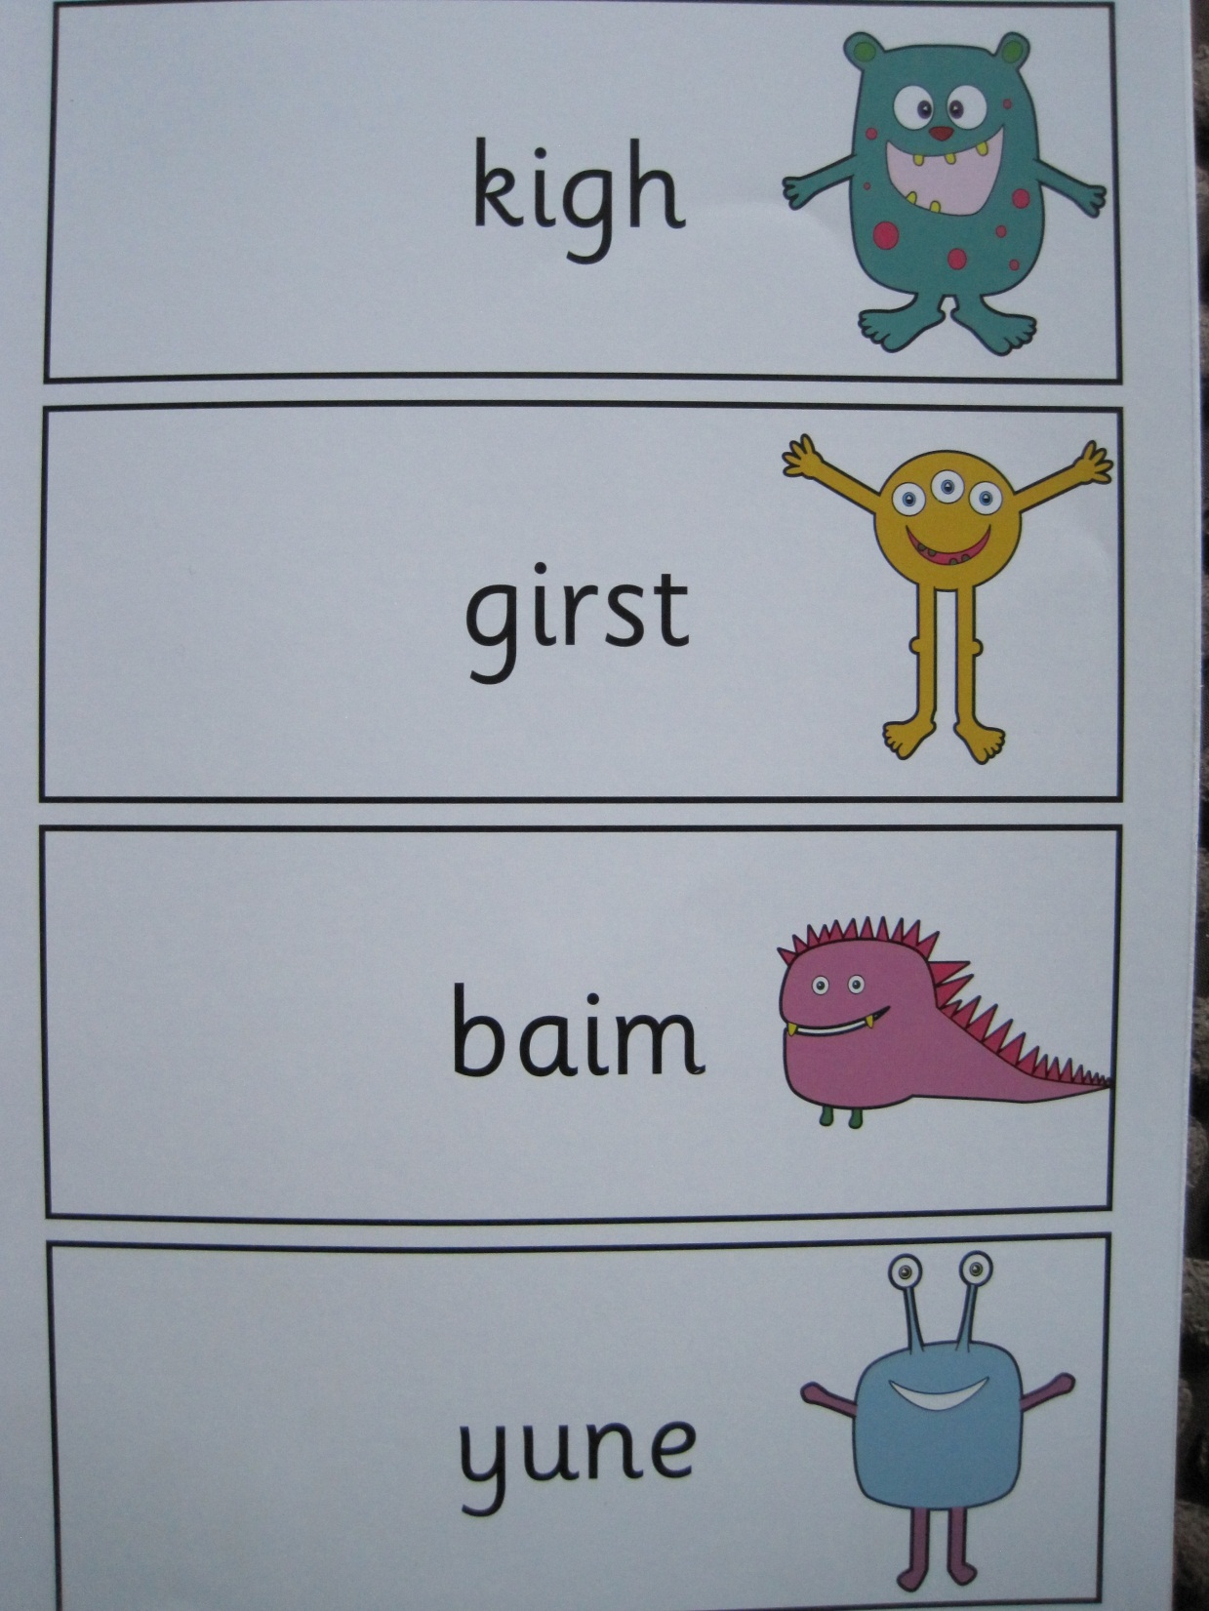

Slide 10
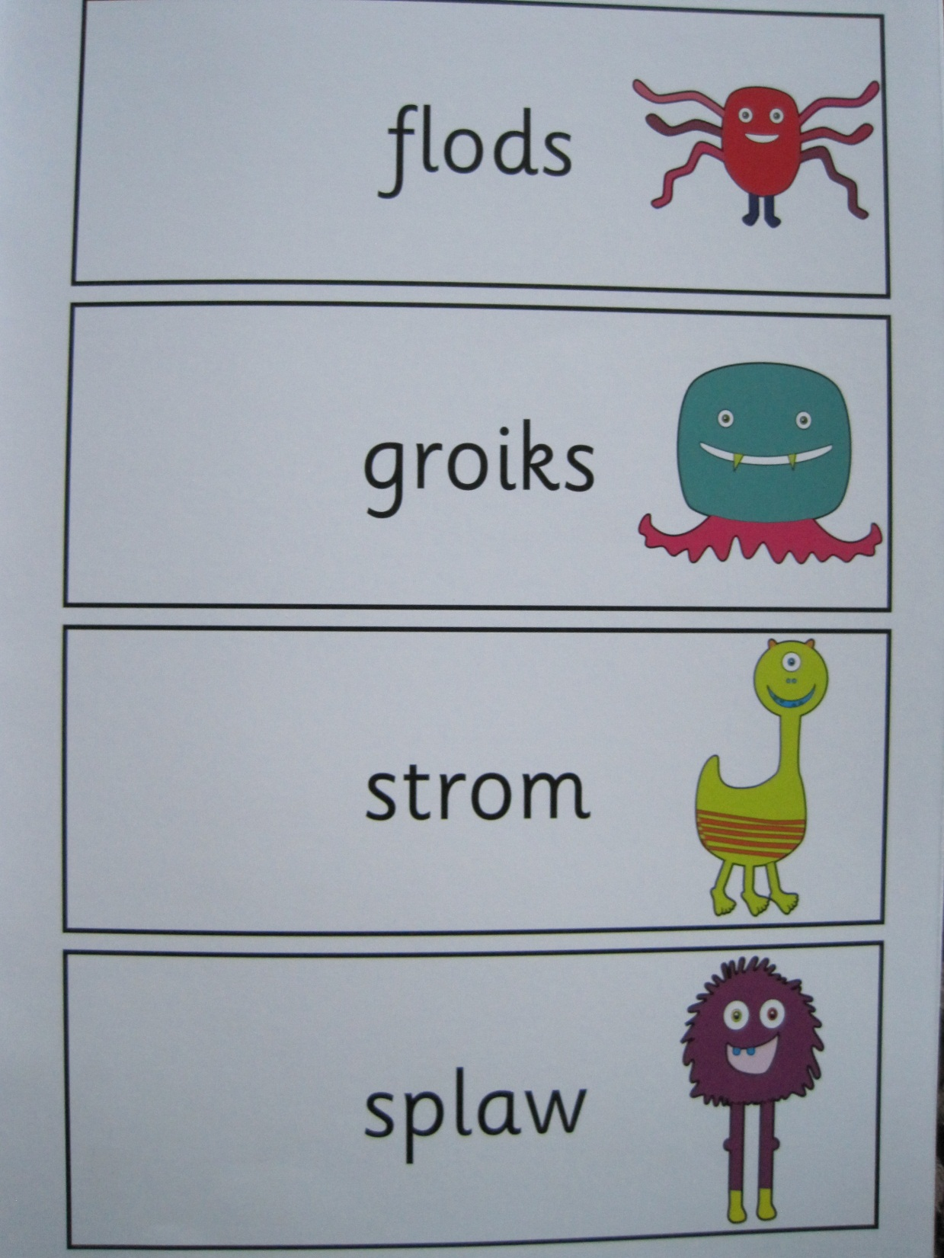
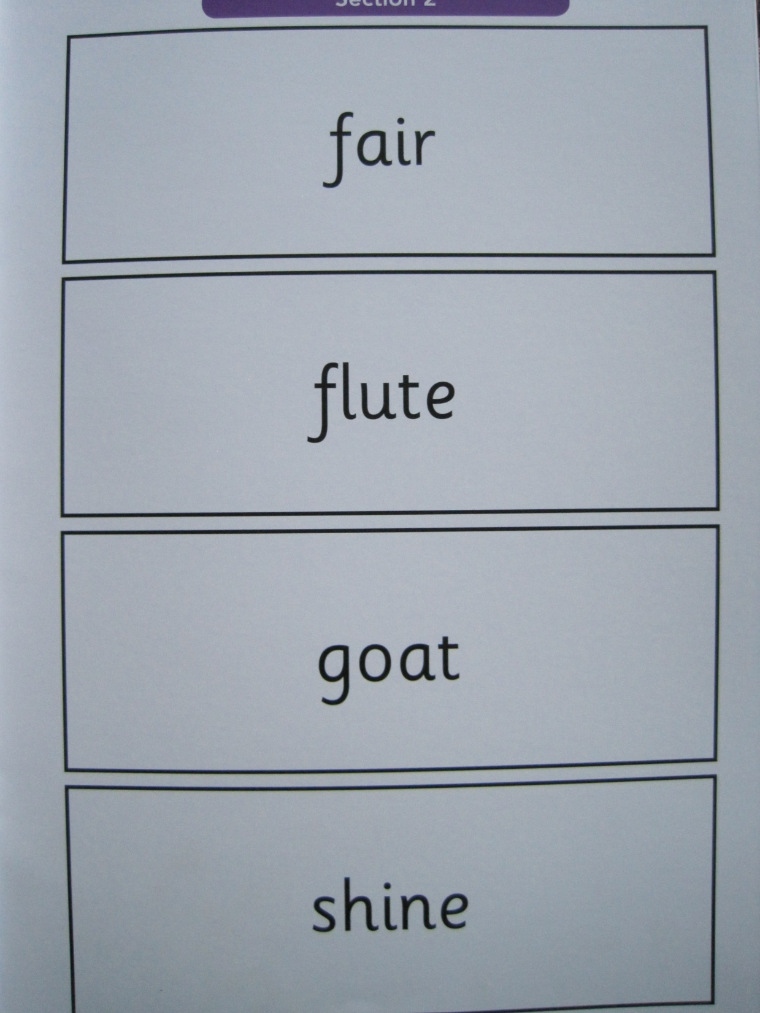

Slide 11
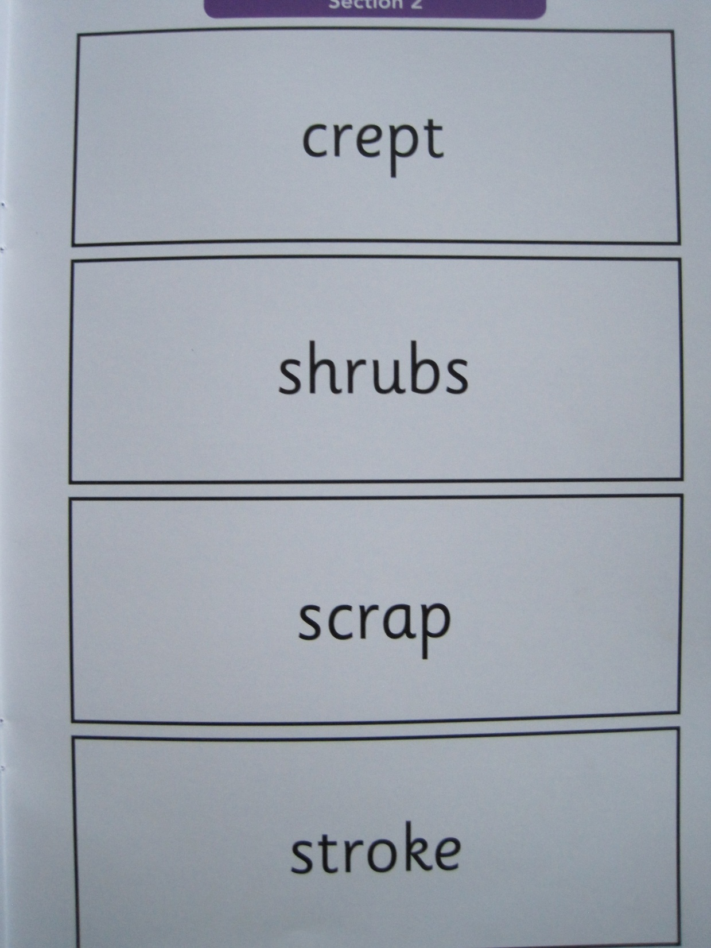
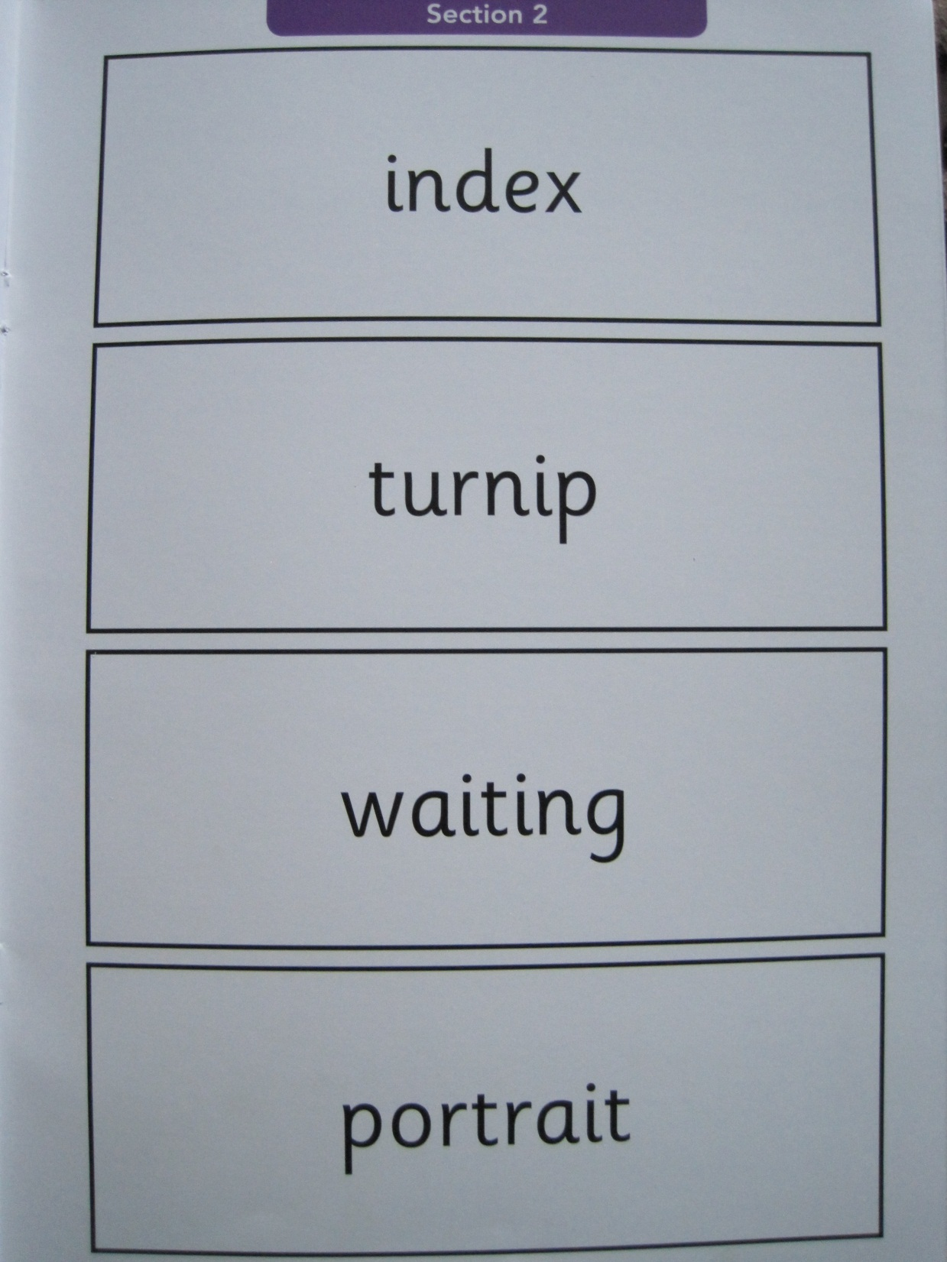

Slide 12
The Score
By the end of the summer term all schools must report each child’s results to their parents. They will also confirm if they have met the standard threshold. Children who do not meet the expected level will retake the test when they are in Year 2.
Results from the check are used by schools to assess where children may need additional support, to assess their own phonics performance and for Ofsted to use in inspections.
The expected level is set each year, it is usually a minimum of 32 out of 40.

Slide 13
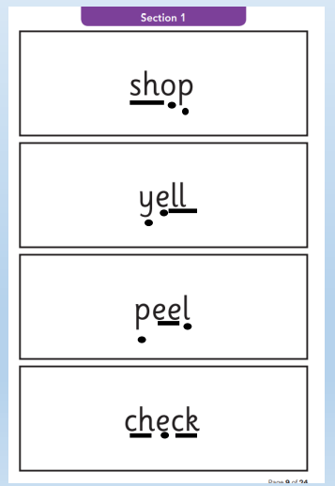
What Can You Do To Support Your Child?
Read with your child every day. Your child’s reading book is matched to their phonics ability and reading it daily is one of the best ways for them to become a confident and fluent reader. Reading not just reading books but encourage reading everywhere!
If your child is finding reading words challenging, encourage them to look for the digraphs and trigraphs in the word and reading them as one sound. This will help them in the assessment too as they will become confident at looking for those graphemes rather than just sounding out each letter.
Encourage your child to use their phonic knowledge and have a go! Give lots of praise and
explain to them what new words mean.
Recap on the phonics learned using the Supersonic Phonic Friends newsletters.
Play games on Phonics Play www.phonicsplay.co.uk

Slide 14
Question Time!

