Slide 1
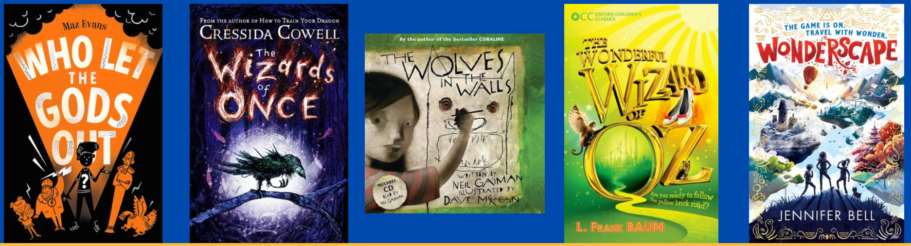
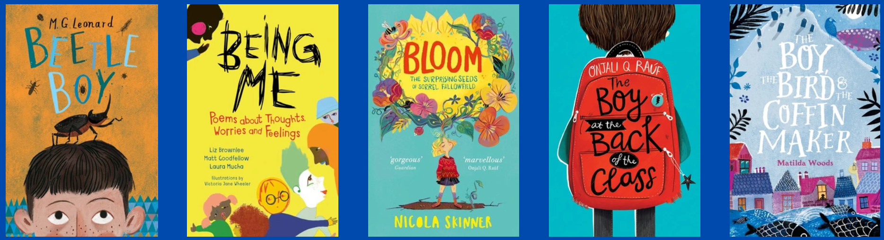
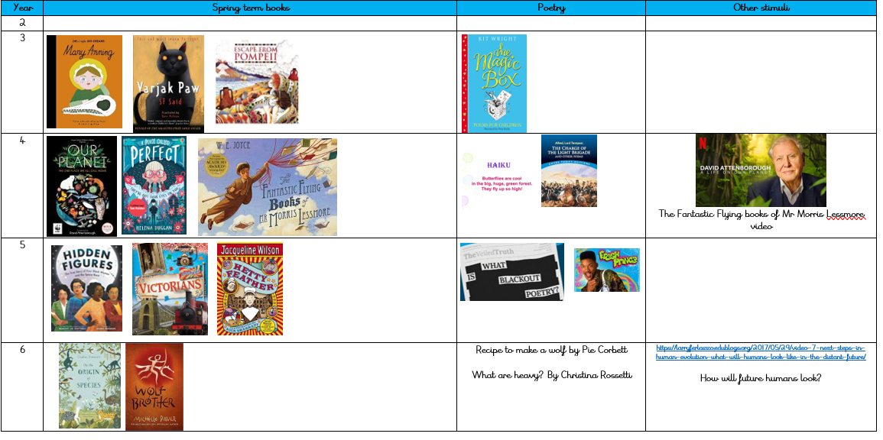
KS2 reading breakfast
Thursday 29th June 2023

Slide 2
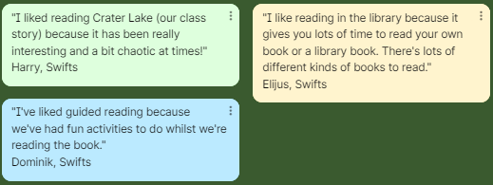
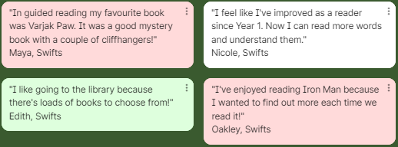

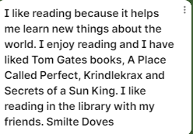
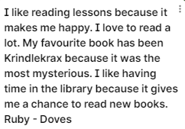

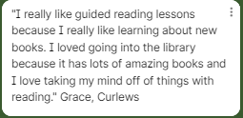

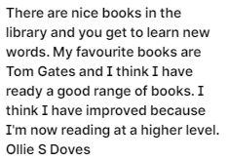
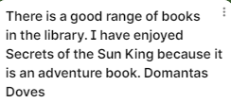

What do your children think about reading at Monkshouse Primary School?

Slide 3
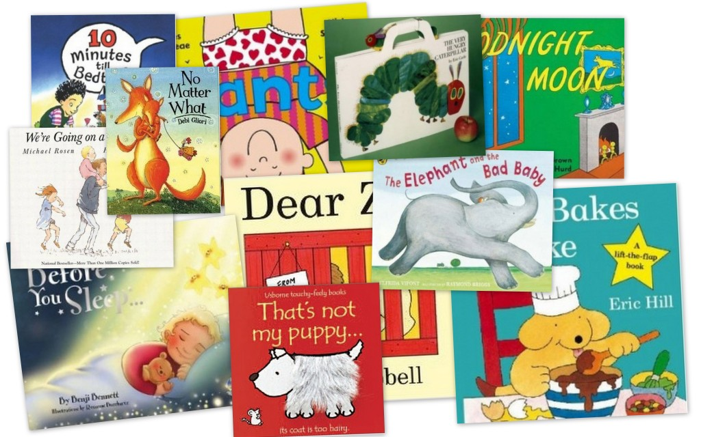
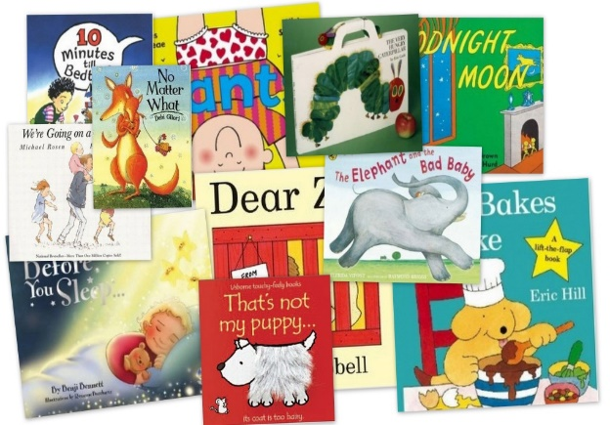
The power of reading!
Creating a love of reading in children is potentially one of the most powerful ways of impacting on academic standards in school.
There can be few better ways to improve pupils' chances in school, or beyond in the wider world, than to enable them to become truly independent readers.
Notes:
If children are happy to read, they are more likely to do so when they have to as well as when they want to.

Slide 4
Comprehension
Reading for pleasure
Decoding

Slide 5
Reading requires two skills…
Understanding
The ability to understand the meaning of the words and sentences in a text.
The ability to understand the ideas, information and themes in a text.
If a child understands what they hear, they will understand the same information when they read.
Phonics and Word Recognition
The ability to recognise words presented in and out of context.
The ability to blend letter sounds together to read words.
Fluency of reading.

Slide 6

The teaching of reading at our school
Phonics (all years if not passed the check).
Fluency (checked half termly).
Whole class reading sessions (fluency and comprehension focus).
Library time (reading for pleasure).
Reading across the curriculum.
Class novels.
Decoding through spelling.
Listening to and questioning children who are reading.
1:1 reading in class weekly (or more).

Slide 7
How do we teach reading in years 3-6?
Daily for 30 – 45 minutes.
4 x classroom-based sessions.
1 x reading for pleasure library session.
Lessons in class are whole class reading sessions – the children are in mixed ability partners and all access the same text and work.
Daily phonics interventions for those in year 3/4 who need it.
A huge focus on high-quality class texts which are mapped out.

Slide 8
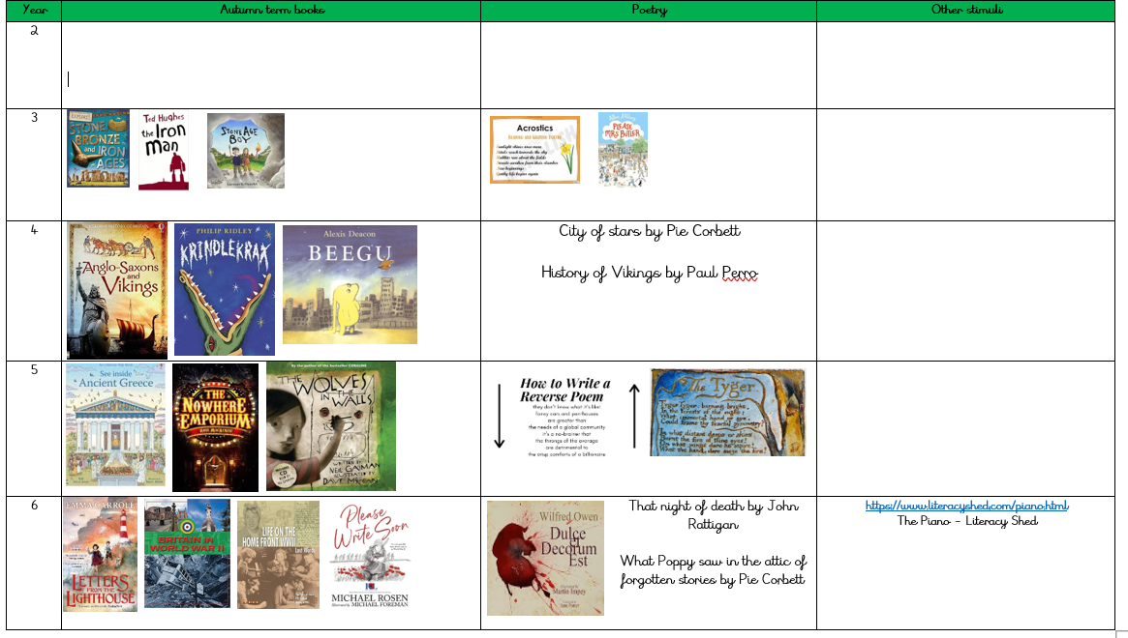

Slide 9

How do we promote a love of reading in school?
Engaging and exciting book corners.
Updated regularly, well-stocked library that is always used.
High-quality texts that often are part of a series.
10 minutes of reading for pleasure daily after lunch.
World book day and reading events.
Termly visits from authors and poets.
Reading dance workshops yearly.
Termly reading newsletter.

Slide 10
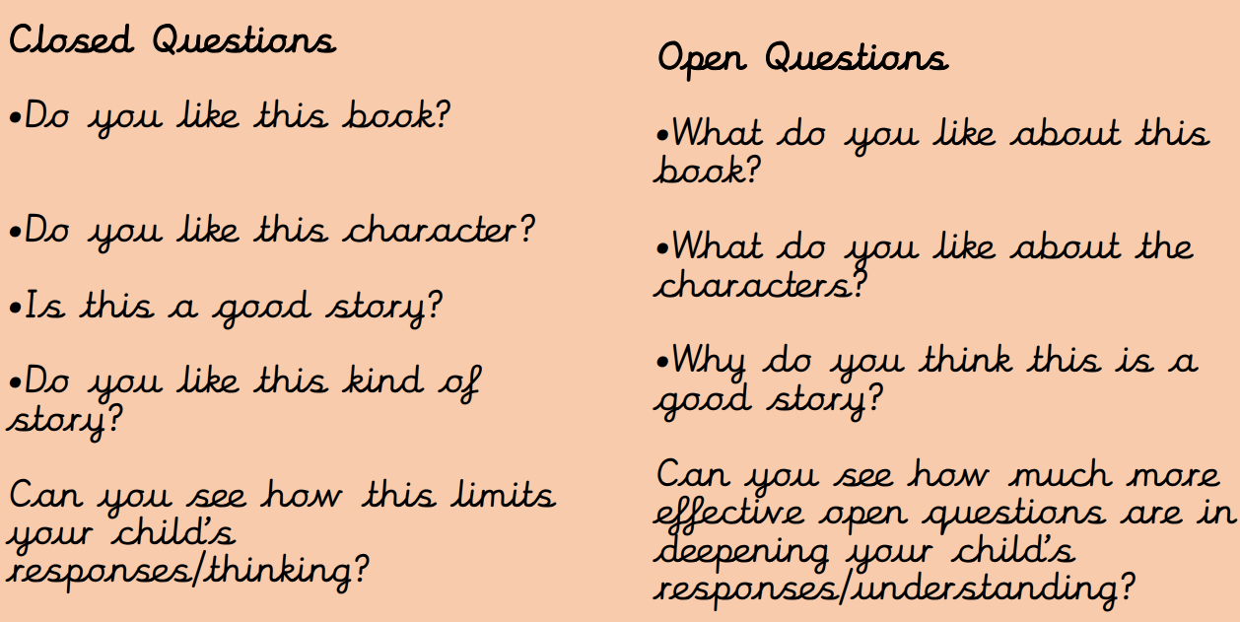
How to question your child at home:

Slide 11
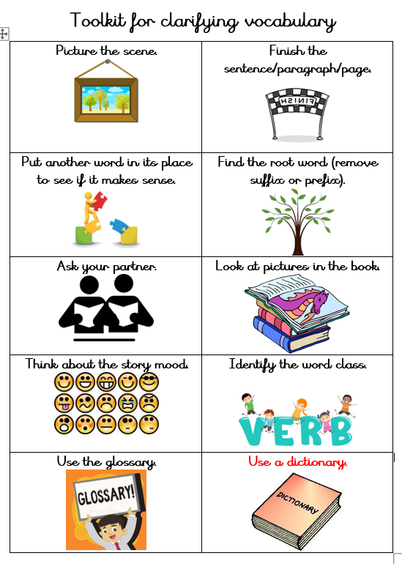
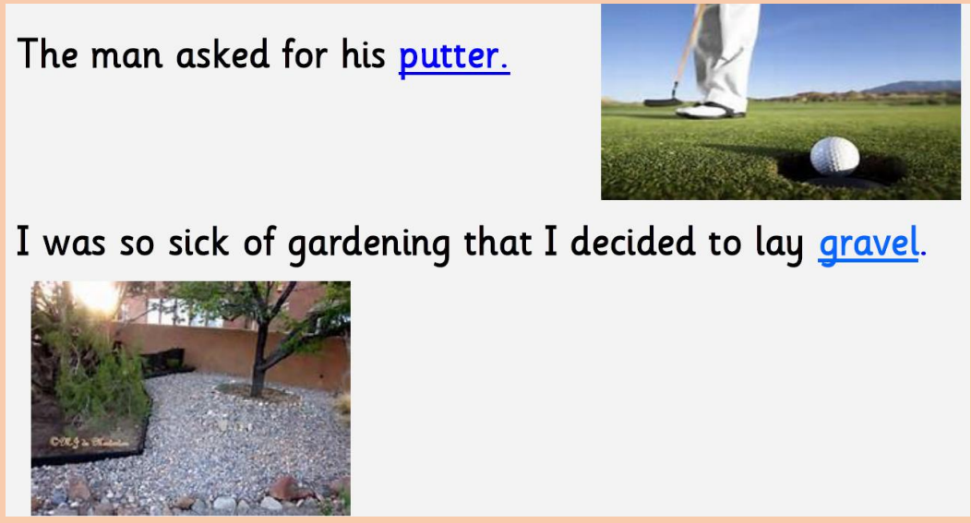

How to help children clarify (understand) unknown words

Slide 12
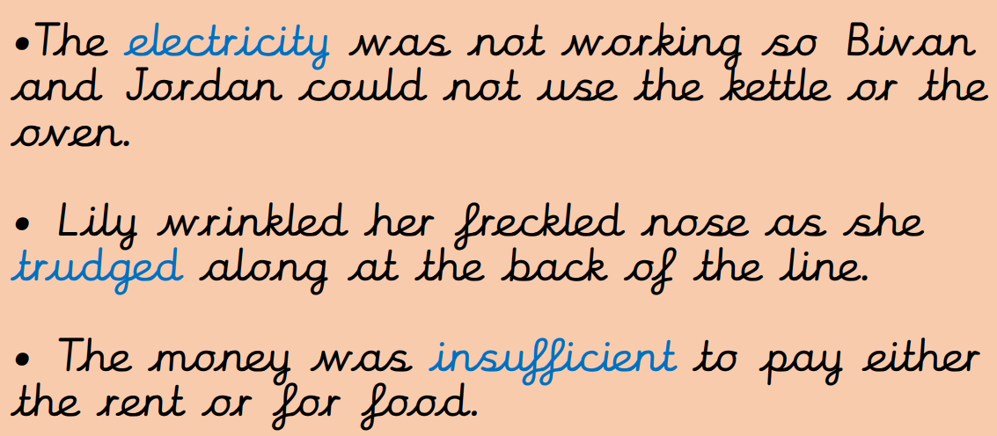

How to help children clarify (understand) unknown words

Slide 13
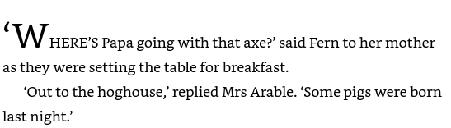



How to help children clarify (understand) unknown words

Slide 14
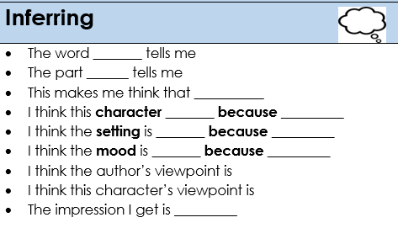
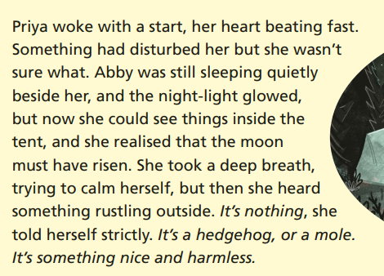
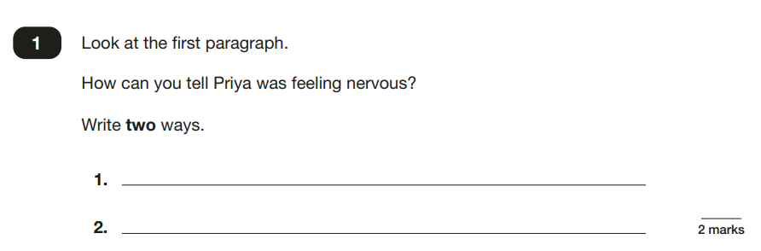
Inference of a text
Arguably the trickiest part of reading.

Slide 15
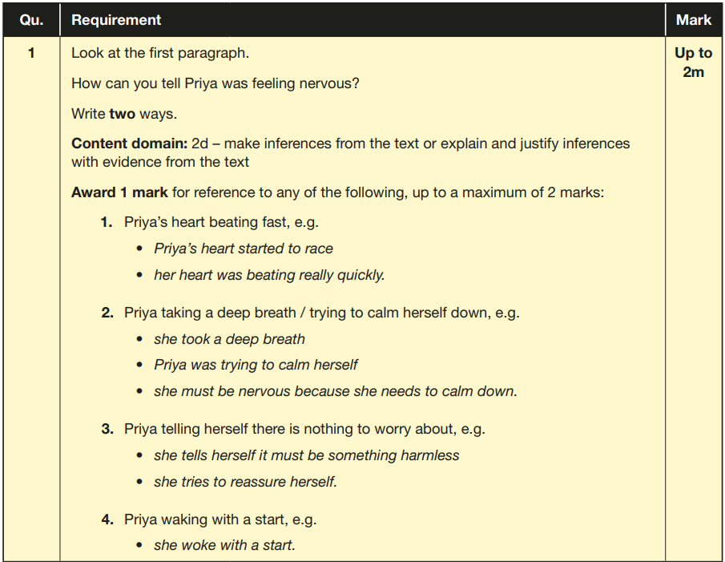

Slide 16
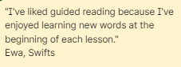
Let’s look at a Y6 lesson together.
Starts with a mini-quiz to recap
Vocabulary checks daily to support with vocabulary building
Modelled reading focused on the objective or question for the lesson
Think alouds by the teacher
Talk partner opportunity
Large chunk of reading – up to 25 minutes in partners.
Quick activity at the end of the lesson

Slide 17
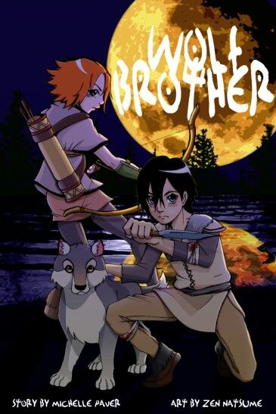
QUICK QUIZ in partners.
What happened in the river?
What did Torak find?
Why is it important for him to find
the three pieces of the Nanuak?

Slide 18
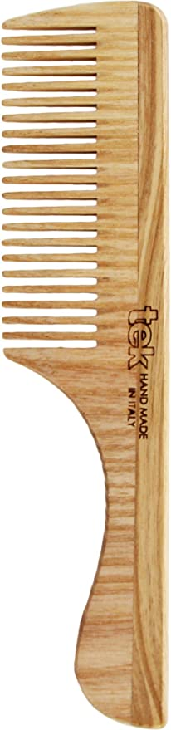
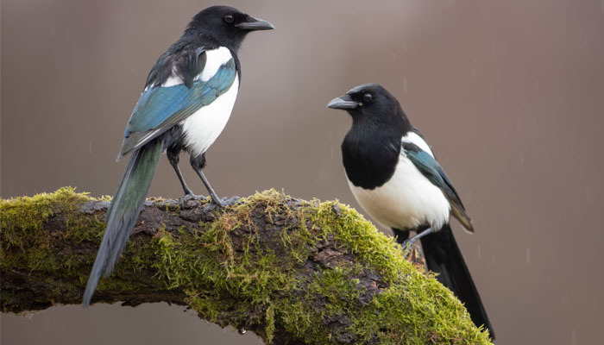
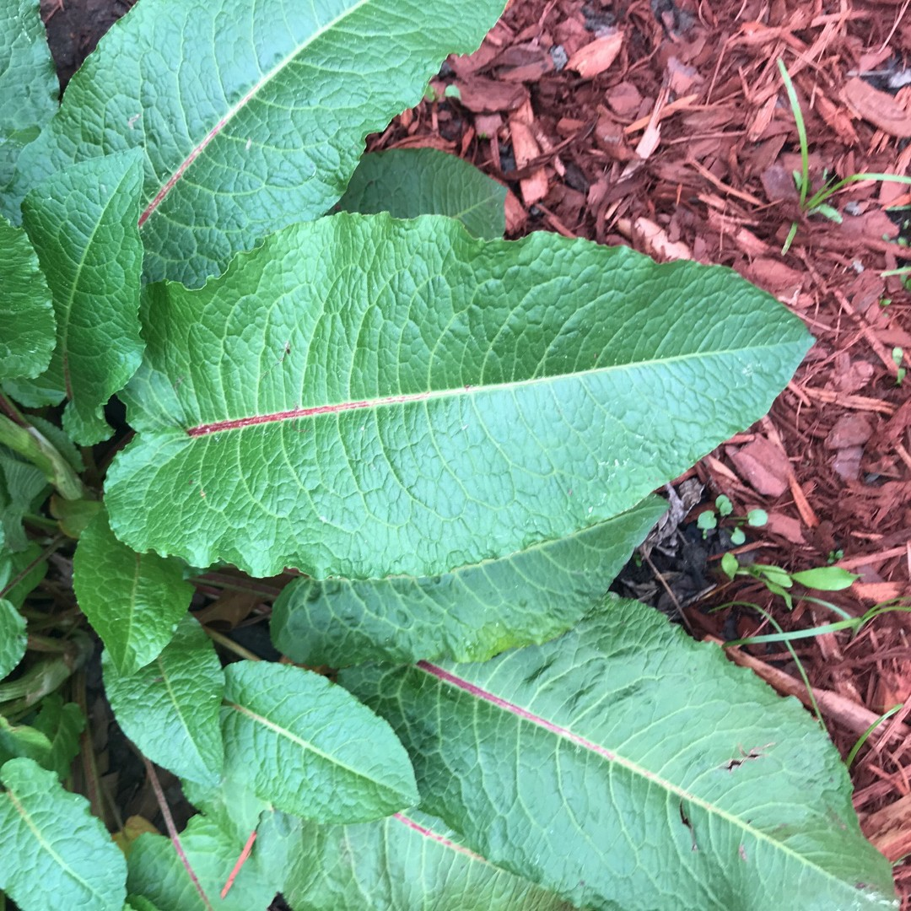
Vocabulary check
Ashwood comb dock leaves
Pair of magpies companionable silence

Slide 19
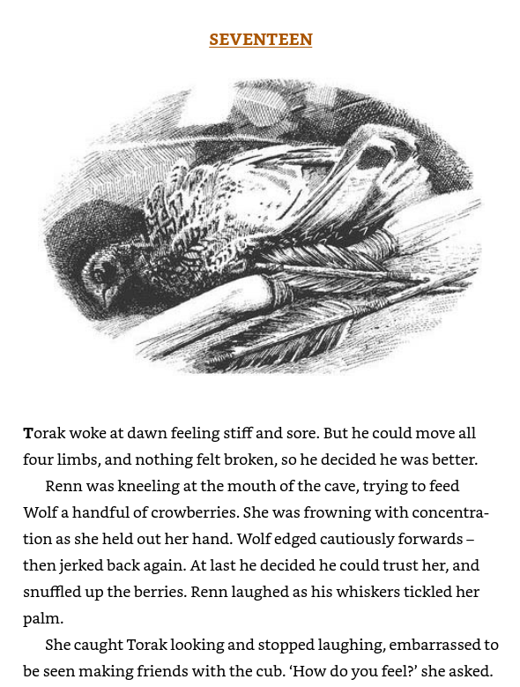


Let’s read up to she asked
TA: I can see that the relationship between Renn and Wolf is changing again. Renn is trying to feed wolf which shows she wants him to like her.
TP: How do you know that Wolf trusts her now? What do you think has created this change in their relationship?

Slide 20
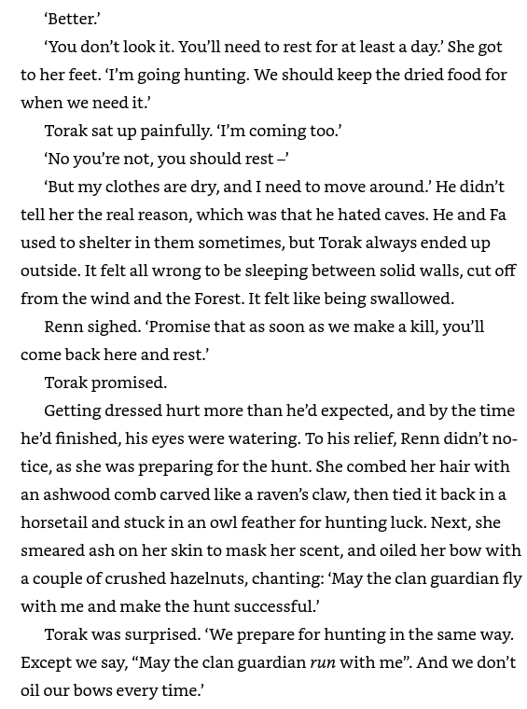

Let’s read up to oil our bows every time.
TA: How can you tell that Renn is an experienced hunter?
Give two ways:
-She knows how to get ready – she’s preparing her hair, skin and bow.
-She is chanting a mantra which shows she knows what to say before a hunt.

Slide 21
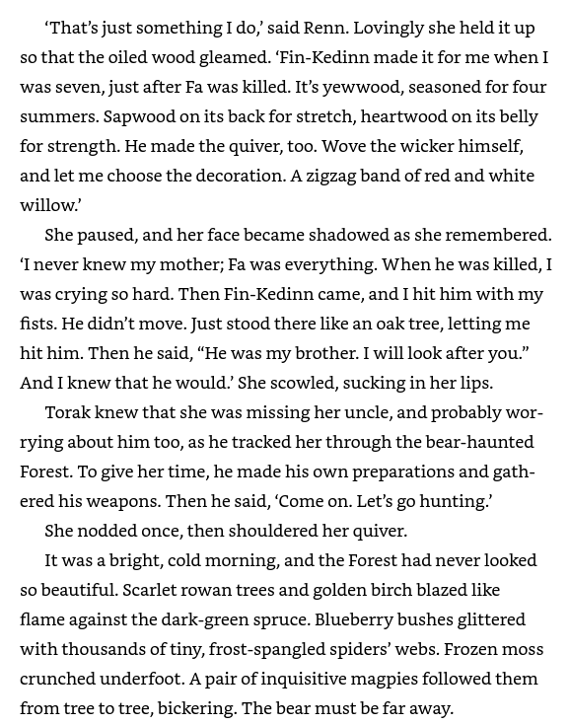

How can you tell that Finn-Kedinn and Renn are close?
TP: Give two ways.

Slide 22

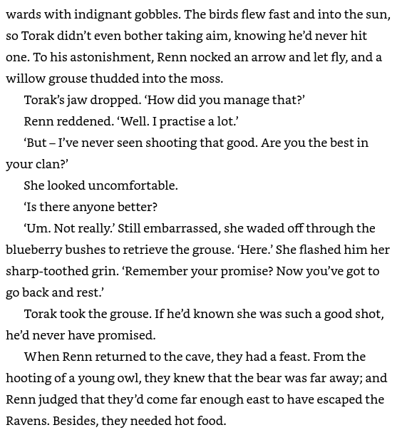

How do you know Renn is talented at hunting?
Find two ways.

Slide 23
TP: Finish chapter 17
Clarify any words and phrases as you go along.
Complete the find two ways activity.

Slide 24
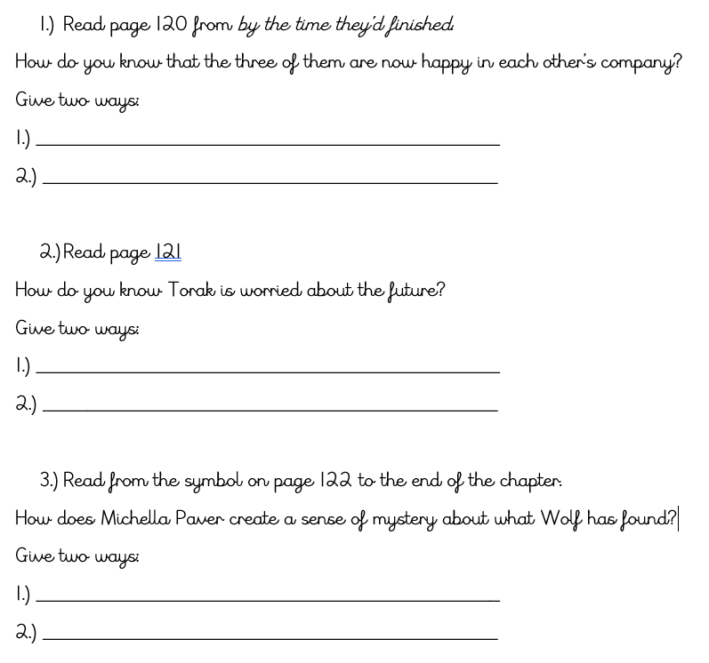
Companionable silence Wolf sits between them Use of the word contented What chance do we have against the bear? How are we going to find the other two pieces of the Nanuak? – he’s questioning himself and the future. She hides the threat so we don’t know what it is. She drops hints that it’s alive but rotten. Saying that its mind seemed broken makes it sound mysterious Unsure if it’s an animal or a human as wolf isn’t sure himself.

Slide 25

How to support at home…
Without the ability to read, your child can’t access the curriculum or school as well.
We ask parents to read with their children 5 x weekly and fill in their child’s reading record.
This is tracked in school and those who are slipping behind are given more support.
This doesn’t have to be just a book: it could be a recipe, blog, newspaper etc. Make it fun and tailor it to your family interests.
Question your children about what they are reading – try to focus on clarifying (understanding) new words and inference.
Buy quality texts for your child – use this website to help you make these choices together: https://www.thereaderteacher.com/

Slide 26
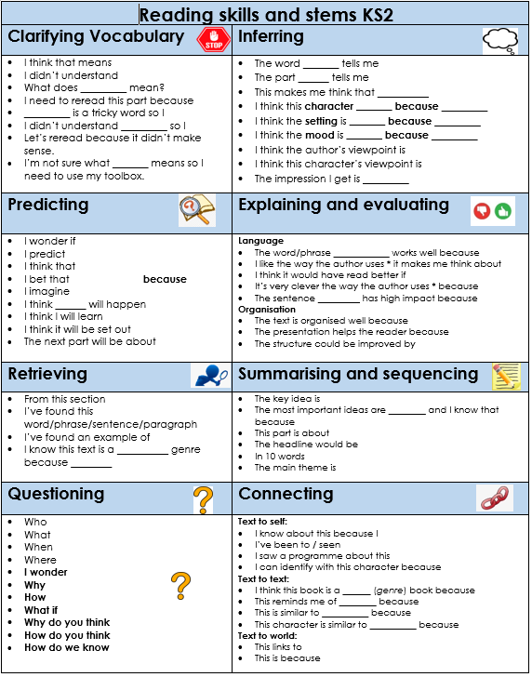
How to support at home…
Use this prompt sheet to help you expand your questioning when reading with your child.

Slide 27
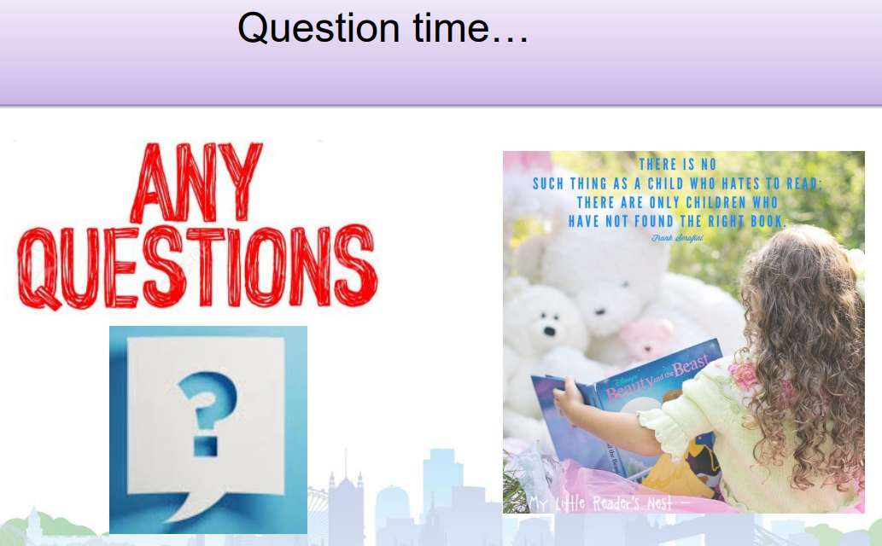

Slide 28
Now grab some breakfast and let’s do some reading with the children!
Browse the selection of books on the tables and select a book you would like to read together.
Let your child read to you and support them with clarifying words.
Can you ask them any inference questions using the prompts?

